Slide 1
Structural Health Monitoring

Slide 2
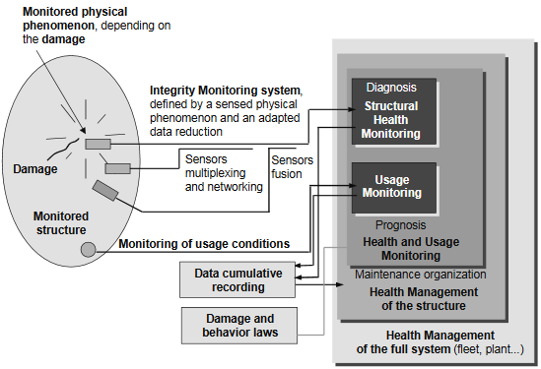
Overview of Structural Health Monitoring
1. Monitoring type of physical phenomenon monitored by sensor
2. Signal produced by sensor is sent to data acquisition system→ Cleaning of Data
3. Mixing the information from integrity monitoring system and knowledge based on damage mechanics and data analytic algorithms→ Feature extraction and data compression
4. Based on the above mentioned steps, it is possible to determine the prognosis (Residual life) and health management of structure→ Statistical model development

Slide 3
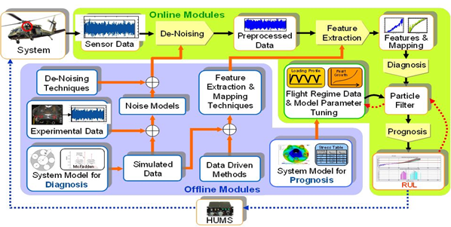
Case Study on SHM in aviation sector
Case: Structural Health Monitoring of Rotor Bearing System (Turbines, Pumps, Compressors, motors, generators etc.)
Mass unbalance, bearing misalignment, fatigue cracks etc. need a great deal of attention→ critical to health of rotor bearing system
Accurate modeling and characterization of the evolution of component health as a function of component loads
Fault diagnosis/prognosis architecture

Slide 4
Thank You

